Slide 1

University of Agricultural Sciences, Dharwad Department of Agricultural Economics
Groundwater marketing in Northern dry zone of Karnataka: Then and now
Major Adviser:
Dr. Mahantesh R. Nayak,
Professor,
Dept. of Agri. Economics.
Presented By:
Yamuna N.,
PGS19AGR8033,
Sr. MSc. Agri.

Slide 2
Introduction
Groundwater supports 1.3 billion people, primary source of irrigation (90% used for irrigation, 2019) and supports 38 % of global irrigation demand.
Groundwater markets in India are informal, localized, unregulated.
Commonly seen in arid and semi arid regions of India and world.
Beneficial to both buyers and sellers as it promotes equity, efficiency and sustainability benefits.
Risk of rapid depletion of aquifers in absence of effective institutions in water markets along with its positive side.

Slide 3
SPECIFIC OBJECTIVES OF STUDY
To study the present status of groundwater markets and their implications on the sustainability in the study area;
To analyse the feasible alternative strategies for conserving water in the water scarce areas;
To measure the positive and negative externalities involved in the ground water markets;
To study and analyse sustainability and equity issues involved in groundwater development in water scarce areas;
To estimate the economic rents to buyers and sellers in the study area; and
To analyse the farm size-wise distribution of households participating in water business and identify the reasons for participation or otherwise in the water business.

Slide 4
Nature and sources of data
Primary data from the sample respondents (n=120)
Secondary data - from District at a Glance of selected districts
-Taluk wise irrigation infrastructures of selected
taluks in 2017-18

Slide 5
Study area
Northern Dry zone of Karnataka
Bagalkot
Hitnalli
10 (F)
Arabhavimath
10 (F)
Bundi (P. M.)
10 (F)
Jagadale
10 (F)
Belagavi
Kannal
10 (F)
Vijayapura
Bibi-ingalagi
10 (F)
Jamkhandi
Navalagi
10 (F)
Mudhol
Jeeragal
10 (F)
Athani
Telsang
10 (F)
Gokak
Shindikurbet
10 (F)
Sindagi
Kalkeri
10 (F)
Vijayapura
Tikota
10 (F)
Note- F = Farmers

Slide 6
Analytical Tools
Tabular analysis
Percentage and ratio analysis
Logit Model
Compounding analysis

Slide 7
Objective 1: To study the present status of ground water markets and their implications on the sustainability in the study area

Slide 8
Table-1 Characteristics of households participating in water markets
SN | Particulars |  | Bagalkot district |  |  | Belagavi district |  |  | Vijayapura district |  |  | Over all
 |  |  | SU | S | B | SU | S | B | SU | S | B | SU | S | B
1 | Number of households (No.) | 2006 | 16 (40.00) | 12 (30.00) | 12 (30.00) | 16 (40.00) | 12 (30.00) | 12 (30.00) | 21 (52.50) | 9 (22.50) | 10 (25.00) | 53 (44.17) | 33 (27.50) | 34 (28.33)
 |  | 2021 | 16 (40.00) | 13 (32.50) | 11 (27.50) | 25 (62.50) | 7 (17.50) | 8 (20.00) | 15 (37.50) | 13 (32.50) | 12 (30.00) | 56 (46.66) | 33 (27.50) | 31 (25.83)
2 | Avg. size of land holding (Ha) | 2006 | 9.56 | 10.12 | 2.76 | 14.09 | 3.44 | 1.42 | 9.46 | 6.12 | 2.72 | 11.03 | 6.56 | 2.3
 |  | 2021 | 4.23 | 3.04 | 1.77 | 1.36 | 2.04 | 1.05 | 5.11 | 3.97 | 3.15 | 3.56 | 3.02 | 1.99
3 | No. of wells per household | 2006 | 3.94 | 3.17 | - | 3.25 | 3.08 | - | 3.45 | 3.32 | - | 3.54 | 3.19 | -
 |  | 2021 | 2.75 | 2.30 | 0.72 | 1.52 | 2.14 | 0.75 | 2.06 | 2.61 | 1.58 | 2.11 | 2.35 | 1.02
4 | Area irrigated per well (Ha) | 2006 | 2.45 | 2.76 | - | 2.02 | 1.86 | - | 3.29 | 3.05 | - | 2.58 | 2.55 | -
 |  | 2021 | 2.34 | 2.59 | 1.77 | 1.35 | 2.12 | 1.13 | 3.03 | 3.26 | 1.67 | 2.24 | 2.66 | 1.52
Note: SU = Self User, S = Seller, B = Buyer,
Figures in parentheses indicate percentages to total.

Slide 9
Table-2 Sources of irrigation for the sample households
Numbers
SN | Particulars | Bagalkot district |  | Belagavi district |  | Vijayapura district |  | Total
 |  | 2006 (n=28) | 2021 (n=37) | 2006 (n=28) | 2021 (n=37) | 2006 (n=30) | 2021 (n=35) | 2006 (n=86) | 2021 (n=109)
1 | Bore wells | 72 (84.00) | 68 (82.92) | 57 (75.00) | 50 (84.74) | 67 (81.00) | 71 (84.52) | 196 (80.00) | 189 (84.00)
2 | Open-cum-Bore wells | 10 (12.00) | 12 (14.63) | 14 (18.00) | 4 (6.77) | 11 (13.00) | 11 (13.09) | 35 (14.00) | 27 (12.00)
3 | Open wells | 4 (4.00) | 2 (2.43) | 5 (7.00) | 5 (8.47) | 5 (6.00) | 2 (2.38) | 14 (6.00) | 9 (4.00)
 | Total | 86 (100.00) | 82 (100.00) | 76 (100.00) | 59 (100.00) | 83 (100.00) | 84 (100.00) | 245 (100.00) | 225 (100.00)
Note: Figures in parentheses indicate percentages to total

Slide 10
Figure 1: Sources of irrigation for the sample households
Sources of irrigation in numbers

Slide 11
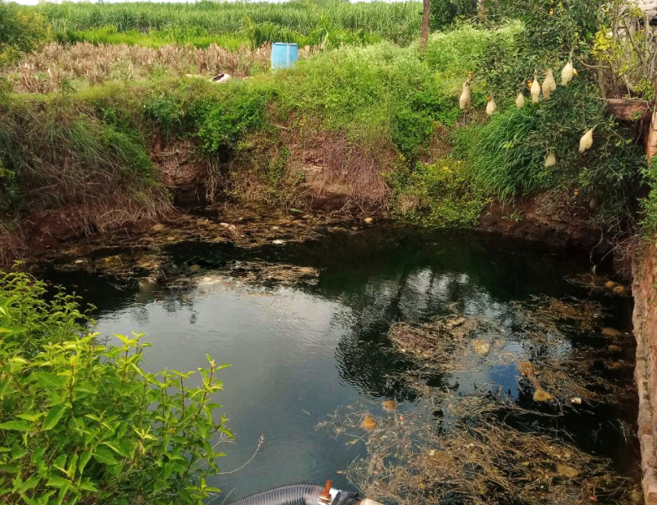
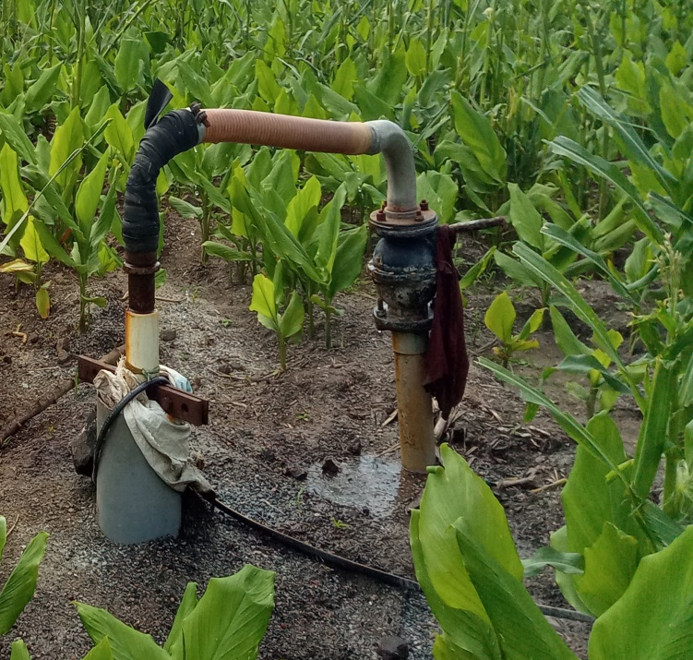
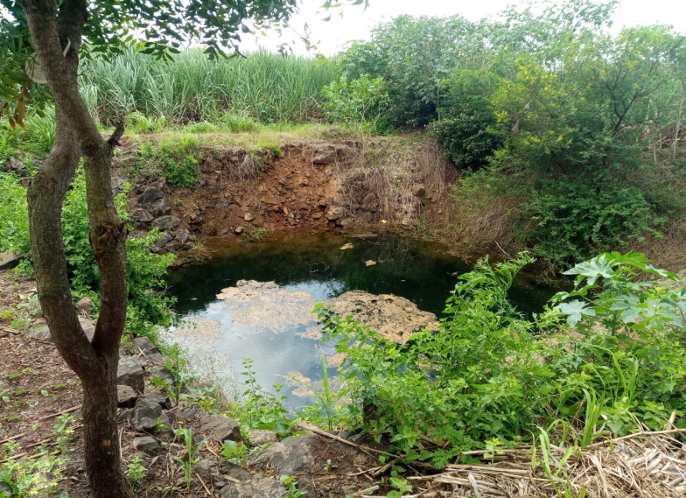
Open well
Bore well
Open cum bore well

Slide 12
Table-3 Well related information of the sample respondents
SN | Particulars | Units | Bagalkot district |  | Belagavi district |  | Vijayapura district |  | Overall
 |  |  | 2006 | 2021 | 2006 | 2021 | 2006 | 2021 | 2006 | 2021
1 | Age of bore well | Years | 12.00 | 7.05 | 10.00 | 8.49 | 14.00 | 14.30 | 12.00 | 9.94
2 | Depth of bore well | Feet | 327.00 | 516.25 | 315.00 | 467.50 | 377 | 495.00 | 340 | 492.91
3 | Average initial yield of bore well | Inches | 3.52 | 3.62 | 3.60 | 3.63 | 3.06 | 3.05 | 3.39 | 3.43
4 | Average present yield of bore well | Inches | 3.09 | 2.92 | 3.70 | 2.87 | 2.54 | 3.09 | 3.11 | 2.96
5 | Changes in water yield- Absolute [(4)-(3)] | Inches | -0.43 | -0.70 | +0.10 | -0.76 | -0.52 | +0.04 | -0.28 | -0.47
6 | Changes in water yield- Percentage [(4)-(3)/ (3)] *100 | % | -12.22 | -19.31 | +2.78 | -21.03 | -16.99 | +1.47 | -8.26 | -12.95
7 | Number of bore wells working | % | 70 | 65.6 | 77 | 73.75 | 62 | 72.50 | 69 | 70.1
8 | Number of bore wells failed | % | 30 | 34.4 | 23 | 26.25 | 38 | 27.50 | 31 | 29.9

Slide 13
Table-4: Self-utilization of groundwater for irrigation of crops by the sample respondents
Numbers of farmers
Particulars |  | Bagalkot district |  |  |  |  | Belagavi district |  |  |  |  | Vijayapura district |  |  |  |  | Total
 |  | K | R | S | P | T | K | R | S | P | T | K | R | S | P | T | K | R | S | P | T
1. Crop Category
HWI | 2006 | 38 | 0 | 0 | 0 | 38 | 8 | 0 | 0 | 12 | 20 | 4 | 2 | 0 | 0 | 6 | 50 | 2 | 0 | 12 | 64
 | 2021 | 26 | 0 | 0 | 0 | 26 | 20 | 4 | 0 | 0 | 24 | 7 | 0 | 0 | 0 | 7 | 53 | 4 | 0 | 0 | 57
MWI | 2006 | 11 | 15 | 0 | 3 | 29 | 14 | 16 | 5 | 10 | 45 | 13 | 9 | 1 | 10 | 33 | 38 | 40 | 6 | 23 | 107
 | 2021 | 22 | 13 | 2 | 8 | 45 | 27 | 26 | 3 | 12 | 68 | 28 | 12 | 2 | 10 | 52 | 77 | 51 | 7 | 30 | 165
LWI | 2006 | 5 | 8 | 6 | 1 | 20 | 0 | 3 | 15 | 3 | 21 | 2 | 1 | 2 | 29 | 34 | 7 | 12 | 23 | 33 | 75
 | 2021 | 17 | 9 | 6 | 20 | 52 | 5 | 6 | 15 | 12 | 38 | 5 | 7 | 2 | 11 | 25 | 27 | 22 | 23 | 43 | 115
Total | 2006 | 54 | 23 | 6 | 4 | 87 | 22 | 19 | 20 | 25 | 86 | 19 | 12 | 3 | 39 | 73 | 95 | 54 | 29 | 68 | 246
 | 2021 | 65 | 22 | 8 | 28 | 123 | 52 | 36 | 18 | 24 | 130 | 40 | 19 | 4 | 21 | 84 | 157 | 77 | 30 | 73 | 337
2. AHP*/season/ha
 | 2006 | 50 | 83 | 85 | 170 | - | 51 | 80 | 95 | 142 | - | 47 | 82 | 86 | 105 | - | 49 | 82 | 89 | 139 | -
 | 2021 | 68 | 78 | 96 | 148 | - | 67 | 95 | 116 | 156 | - | 55 | 92 | 93 | 170 | - | 63 | 88 | 101 | 158 | -
Note: HWI=High Water Intensive; M=Medium Water Intensive; L=Low Water Intensive crops;
K=Kharif ; R=Rabi; S=Summer; P=Perennial; T=Total, AHP = Average hours of pumping.

Slide 14
Table-5: Temporal groundwater depletion in the study area
 |  | Year | Belagavi district |  |  | Vijayapura district |  |  | Bagalkot district |  |  | Overall Average
 |  |  | Mean depth (ft) | Increase over previous period (ft) | % Increase over previous period | Mean depth (ft) | Increase over previous period (ft) | % Increase over previous period | Mean depth (ft) | Increase over previous period (ft) | % Increase over previous period | Mean depth (ft) | Increase over previous period (ft) | % Increase over previous period
Past study | Period I | 1980-90 | 201 | - | - | 305 | - | - | 285 | - | - | 264 | - | -
 | Period II | 1991-00 | 268 | 67 | 33.33 | 350 | 45 | 14.75 | 318 | 33 | 11.58 | 312 | 48 | 18.33
Present study | Period III | 2001-10 | 360 | 92 | 34.32 | 415 | 65 | 18.57 | 397 | 79 | 24.84 | 391 | 79 | 25.21
 | Period IV | 2010-20 | 490 | 130 | 36.11 | 503 | 88 | 21.20 | 519 | 122 | 30.73 | 504 | 113 | 29.01

Slide 15
Mean depth in feet
Figure 2: Temporal groundwater depletion in the study area

Slide 16
Table-6: Opinions on reasons for fall in water table
Per cent
SN | Reasons | Belagavi district (n=40) |  | Vijayapura district (n=40) |  | Bagalkot district (n=40) |  | Total (n=120)
 |  | 2006 | 2021 | 2006 | 2021 | 2006 | 2021 | 2006 | 2021
1 | Decrease in rainfall | 86.00 | 72.99 | 64.00 | 82.85 | 57.00 | 81.08 | 69.00 | 78.89
2 | Increase in number of wells | 27.00 | 43.24 | 9.00 | 51.42 | 43.00 | 45.95 | 26.00 | 46.78
3 | Increase in area under irrigation | 0.00 | 13.51 | 13.00 | 17.14 | 0.00 | 13.51 | 4.00 | 14.67
4 | Decrease in surface water sources | 7.00 | 8.10 | 0.00 | 5.71 | 4.00 | 2.70 | 4.00 | 5.50

Slide 17
Objective 2: To analyse the feasible alternative strategies for conserving water in the water scarce areas

Slide 18
Table-7: Extent of ground water marketing
Particulars | Bagalkot district |  |  |  | Belagavi district |  |  |  | Vijayapura district |  |  |  | Overall
 | 2006 |  | 2021 |  | 2006 |  | 2021 |  | 2006 |  | 2021 |  | 2006 |  | 2021
 | No | % | No. | % | No. | % | No. | % | No. | % | No | % | No. | % | No. | %
SU | 16 | 40.00 | 16 | 40.00 | 16 | 40.00 | 25 | 62.50 | 21 | 52.50 | 15 | 37.50 | 53 | 44.17 | 56 | 46.66
S | 12 | 30.00 | 13 | 32.50 | 12 | 30.00 | 7 | 17.50 | 9 | 22.50 | 13 | 32.50 | 33 | 27.50 | 33 | 27.50
B | 12 | 30.00 | 11 | 27.50 | 12 | 30.00 | 8 | 20.00 | 10 | 25.00 | 12 | 30.00 | 34 | 28.33 | 31 | 25.83
T | 40 | 100 | 40 | 100 | 40 | 100 | 40 | 100 | 40 | 100 | 40 | 100 | 120 | 100 | 120 | 100
Total area irrigated (ha)
SU | 111.00 | 56.92 | 67.77 | 53.39 | 51.00 | 52.04 | 34.02 | 59.93 | 121.00 | 71.18 | 76.68 | 46.12 | 283.00 | 61.12 | 178.49 | 51.00
S | 64.00 | 32.82 | 39.60 | 31.20 | 35.00 | 35.71 | 14.29 | 25.17 | 41.00 | 24.12 | 51.71 | 31.10 | 140.00 | 30.24 | 105.61 | 30.17
B | 20.00 | 10.26 | 19.54 | 15.39 | 12.00 | 12.25 | 8.45 | 14.88 | 8.00 | 4.70 | 37.85 | 22.76 | 40.00 | 8.64 | 65.84 | 18.81
T | 195.00 | 100 | 126.92 | 100 | 98.00 | 100 | 56.77 | 100 | 170.00 | 100 | 166.25 | 100 | 463.00 | 100 | 349.95 | 100
Area irrigated per farm household (ha)
SU | 6.94 |  | 4.23 |  | 3.19 |  | 1.36 |  | 5.76 |  | 5.11 |  | 5.34 |  | 3.18
S | 5.33 |  | 3.04 |  | 2.91 |  | 2.04 |  | 4.55 |  | 3.97 |  | 4.24 |  | 3.20
B | 1.66 |  | 1.77 |  | 1.00 |  | 1.05 |  | 0.80 |  | 3.15 |  | 1.17 |  | 2.12
Note: SU = Self User, S = Seller, B = Buyer, T = Total
.

Slide 19
Figure 1.3: Composition of sample respondents

Slide 20
Figure 1.4: Total area irrigated

Slide 21
Table-8: Opinions of respondents with respect to ground water security
SN | Particulars | Bagalkot district |  | Belagavi district |  | Vijayapura district |  | Total
 |  | n = 28 | n = 37 | n = 30 | n = 35 | n = 28 | n = 37 | n = 86 | n = 109
 |  | 2006 | 2021 | 2006 | 2021 | 2006 | 2021 | 2006 | 2021
a. | Respondents ‘secure’ with respect to groundwater | 9 (32.00) | 12 (32.43) | 1 (3.00) | 9 (25.71) | 8 (29.00) | 7 (18.91) | 18 (21.00) | 28 (25.68)
b. | Respondents ‘insecure’ with respect to groundwater | 19 (68.00) | 25 (67.56) | 29 (97.00) | 26 (74.28) | 20 (71.00) | 30 (81.08) | 68 (79.00) | 81 (74.31)
Reason for ‘insecure’ feeling of the respondents with respect to ground water
1 | Depletion of water table | 14 (74.00) | 22 (59.45) | 29 (100.00) | 26 (74.28) | 18 (90.00) | 29 (78.37) | 61 (90.00) | 77 (70.64)
2 | Low rainfall | 16 (84.00) | 25 (67.56) | 26 (90.00) | 26 (74.28) | 12 (60.00) | 30 (81.08) | 54 (79.00) | 81 (74.31)
3 | Continuous drought | 10 (53.00) | 7 (18.91) | 20 (69.00) | 11 (31.42) | 12 (60.00) | 9 (24.32) | 42 (62.00) | 27 (24.77)
4 | Increase in number of bore wells | 12 (63.00) | 21 (56.75) | 19 (66.00) | 25 (71.42) | 10 (50.00) | 25 (67.56) | 41 (60.00) | 71 (65.13)
5 | Lack of ponds, tanks and streams near to his farm | 11 (58.00) | 18 (48.64) | 13 (45.00) | 21 (60.00) | 8 (40.00) | 19 (51.35) | 32 (47.00) | 58 (53.21)
6 | Fear of the neighbouring farmers drilling bore wells adjacent/very near to his own | 9 (47.00) | 19 (51.35) | 10 (34.00) | 22 (62.85) | 6 (30.00) | 26 (70.27) | 25 (37.00) | 67 (61.46)
7 | Over extraction of groundwater from aquifer | 3 (16.00) | 2 (5.40) | 8 (28.00) | 4 (11.42) | 9 (45.00) | 3 (8.10) | 20 (29.00) | 9 (8.25)
Note: Figures in parentheses indicate percentages to total.

Slide 22
Table-9: Water conservation strategies suggested by the respondents for water scarce areas
SN | Particulars | Bagalkot district (n=40) |  | Belagavi district (n=40) |  | Vijayapura district (n=40) |  | Total
 |  | 2006 | 2021 | 2006 | 2021 | 2006 | 2021 | 2006 | 2021
1 | Changing the irrigation method (alternate-furrow irrigation, sprinklers, drip, etc. involving judicious water use) | 27 (67.50) | 26 (65.00) | 29 (72.50) | 32 (80.00) | 27 (67.50) | 35 (87.50) | 83 (69.16) | 93 (77.50)
2 | Growing LWI crop | 23 (57.50) | 15 (37.50) | 31 (77.50) | 12 (30.00) | 11 (27.50) | 11 (27.50) | 65 (54.16) | 38 (31.66)
3 | Growing of HWI crops on limited area | 24 (60.00) | 26 (65.00) | 10 (25.00) | 22 (55.00) | 29 (72.50) | 25 (62.50) | 63 (52.50) | 73 (60.83)
4 | Reducing frequency of irrigation (protective irrigation) | 10 (25.00) | 8 (20.00) | 8 (20.00) | 5 (12.50) | 13 (32.50) | 7 (17.50) | 31 (25.83) | 20 (16.66)
5 | Reducing overall pumping hours | 13 (32.50) | 11 (27.50) | 9 (22.50) | 13 (32.50) | 7 (17.50) | 9 (22.50) | 29 (24.16) | 33 (27.50)
Note: Figures in parentheses indicate percentage to total.

Slide 23
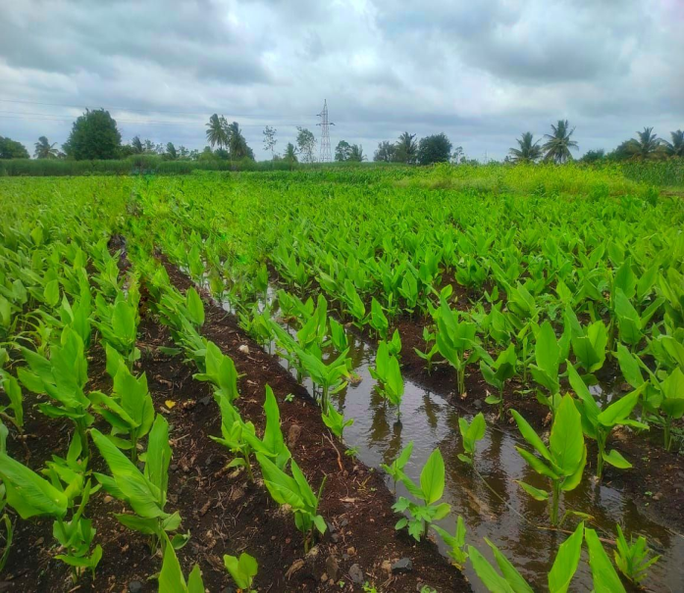
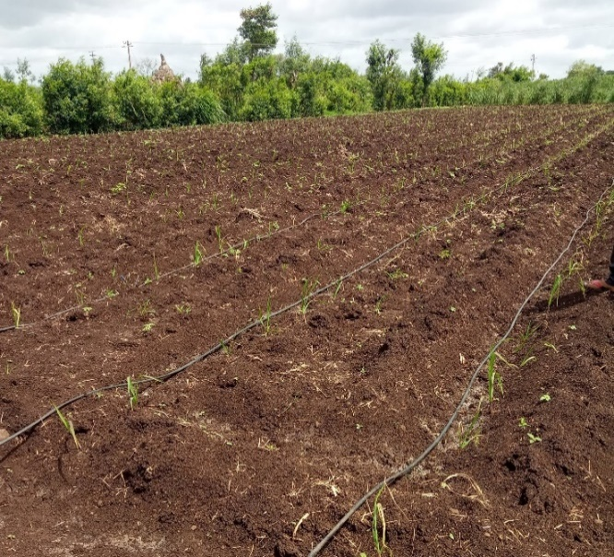
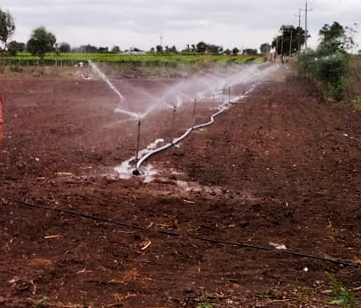
Furrow Irrigation
Drip Irrigation
Sprinkler Irrigation

Slide 24
Table-10: Measures undertaken by the well owner respondents to improve groundwater resources
SN | Particulars | Bagalkot district |  | Belagavi district |  | Vijayapura district |  | Total
 |  | (n = 28) | (n = 37) | (n =30) | (n =35) | (n = 28) | (n = 37) | (n=86) | (n=109)
 |  | 2006 | 2021 | 2006 | 2021 | 2006 | 2021 | 2006 | 2021
1 | Cultivation of LWI crops | 11 (39.29) | 9 (24.32) | 27 (90.00) | 11 (31.42) | 4 (14.29) | 3 (8.10) | 47 (54.65) | 23 (21.10)
2 | Conservation of water for future use | 12 (42.86) | 13 (35.13) | 24 (80.00) | 15 (42.85) | 7 (25.00) | 7 (18.91) | 43 (50.00) | 35 (32.11)
3 | Construction of water harvesting structures jointly by farmers and the Government/NGO | 8 (28.57) | 15 (40.54) | 13 (43.33) | 11 (31.42) | 4 (14.19) | 9 (24.32) | 25 (29.07) | 35 (32.11)
4 | Reduction in overall pumping hours | 3 (10.71) | 5 (13.51) | 16 (53.33) | 7 (20.00) | 3 (10.71) | 4 (10.81) | 22 (25.58) | 16 (14.67)
5 | Construction of water harvesting structures with own resources | 0 (0.00) | 0 (0.00) | 7 (23.33) | 4 (11.42) | 6 (21.43) | 6 (16.21) | 13 (15.12) | 10 (9.17)
6 | Other measures (alternate-furrow irrigation, change in planting methods, diverting streams to wells, lifting water from tank to wells etc.) | 5 (17.86) | 12 (32.43) | 9 (30.00) | 17 (48.57) | 10 (35.71) | 18 (48.64) | 24 (27.91) | 47 (43.11)
Note: Figures in parentheses indicate percentages to total.

Slide 25
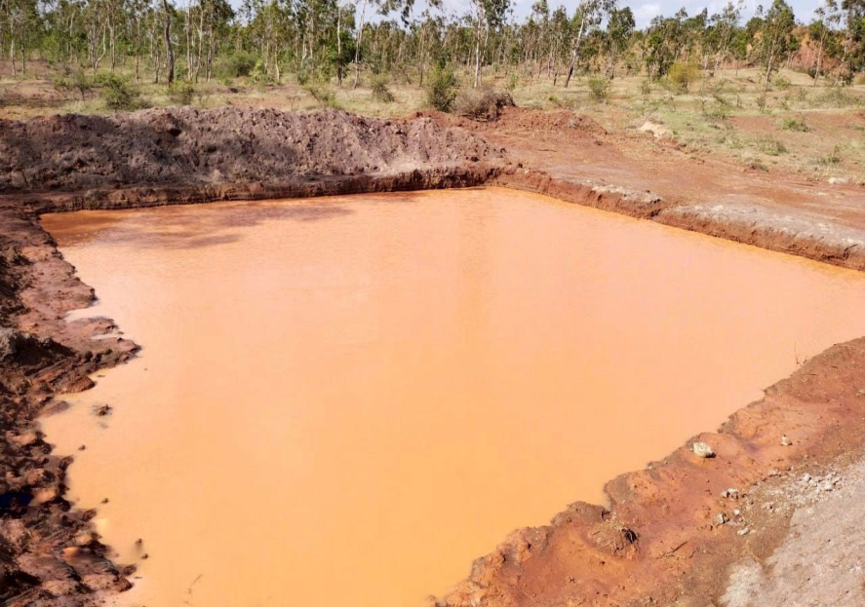
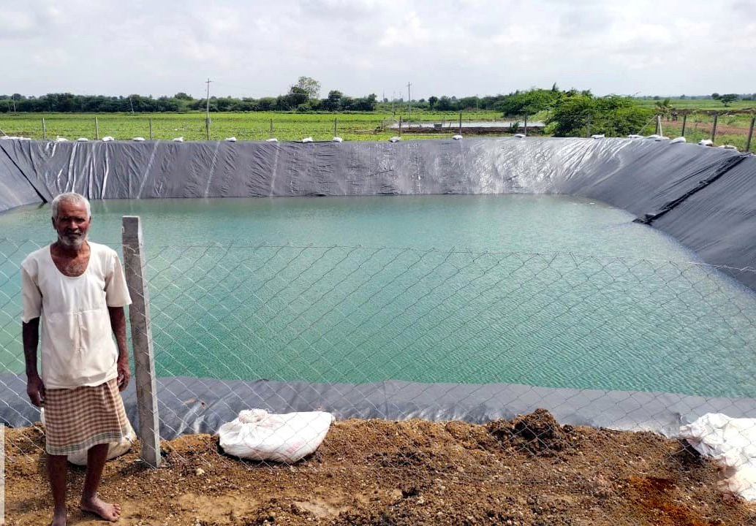
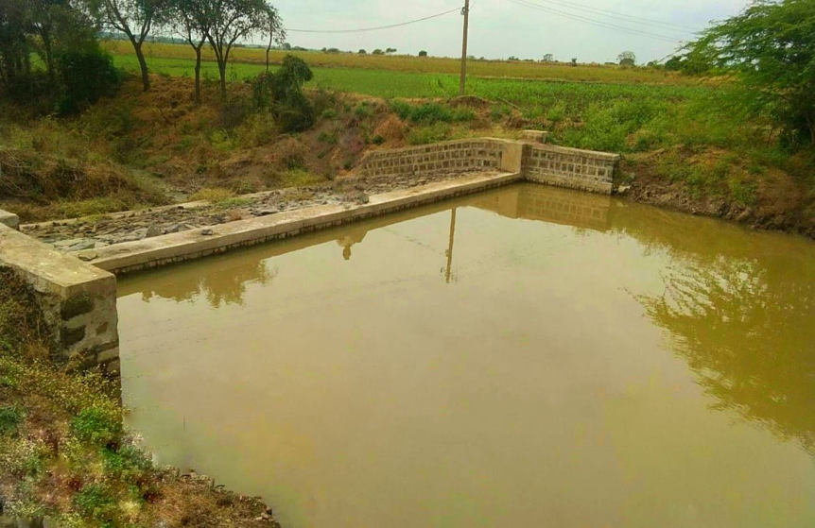
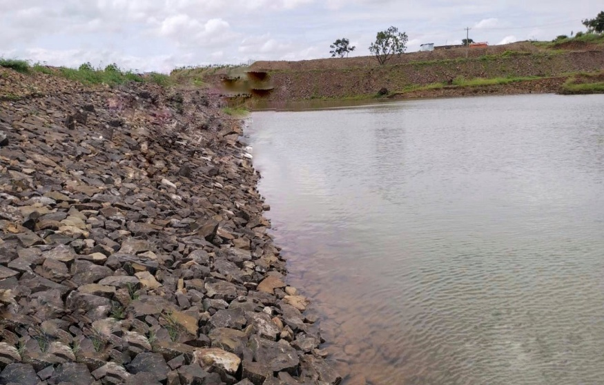
Step Farm pond
Farm pond
Check Dam
Nala Bund

Slide 26
Objective 3: To measure the positive and negative externalities involved in the ground water markets

Slide 27
Table-11: Direct Gross Benefits from Groundwater Marketing
Rs/ha
SN | Particulars |  | Average gross returns to the seller due to sale of water |  | Additional gross returns to the buyer due to ‘irrigated farming’ (through purchase of water) over ‘rainfed farming’ |  | Average gross returns under ‘rainfed framing’ |  | Direct gross benefit (Rs/ha) to farmers due to water marketing [C(1)+C(2)]
 |  |  | 2006 | 2021 | 2006 | 2021 | 2006 | 2021 | 2006 | 2021
1 | Belagavi district | K | 3,198 | 5,945 | 9,594 | 20,345 | 5,708 | 15,250 | 12,792 | 26,290
2 |  | R | 2,855 | 5,545 | 8,565 | 17,650 | 5,665 | 15,030 | 11,420 | 23,195
3 |  | S | 3,308 | 6,734 | 9,924 | 16,322 | - | - | 13,232 | 23,056
4 |  | P | 18,745 | 39,845 | 56,235 | 89,655 | - | - | 74,980 | 1,29,500
5 | Vijayapura district | K | 3,458 | 6,542 | 10,374 | 23,453 | 5,023 | 14,750 | 13,832 | 29,995
6 |  | R | 3,247 | 6,452 | 9,741 | 21,654 | 7,161 | 13670 | 12,988 | 28,106
7 |  | S | 3,648 | 3,894 | 10,944 | 24,362 | - | - | 14,592 | 28,256
8 |  | P | 29,547 | 43,120 | 88,641 | 1,03,620 | - | - | 1,18,188 | 1,46,740
9 | Bagalkot district | K | - | 6,324 | - | 25,365 | 4,774 | 14,560 | - | 31,689
10 |  | R | - | 5,645 | - | 23,568 | 4,675 | 12,750 | - | 29,213
11 |  | S | - | 6,253 | - | 24,980 | - | - | - | 31,233
12 |  | P | 19,470 | 40,232 | 58,410 | 95,620 | - | - | 77,880 | 1,35,852
13 | Average | K | 3,328 | 6,270 | 9,984 | 23,054 | 5,168 | 14,853 | 13,312 | 29,324
14 |  | R | 3,051 | 5,880 | 9,153 | 20,957 | 5,866 | 13,816 | 12,204 | 26,838
15 |  | S | 3,478 | 5,627 | 10,434 | 21,888 | - | - | 13,912 | 27,515
16 |  | P | 22,587 | 41,065 | 67,762 | 96,298 | - | - | 90,349 | 1,37,364
Note: C = columns, K=Kharif ; R=Rabi; S=Summer; P=Perennial.

Slide 28
Table-12: Effect of well construction/pumping by neighbouring farmers on the respondents
SN | Particulars | Belagavi district |  | Vijayapura district |  | Bagalkote district |  | Total
 |  | 2006 | 2021 | 2006 | 2021 | 2006 | 2021 | 2006 | 2021
 |  | (n = 28) | (n = 37) | (n = 30) | (n = 35) | (n = 28) | (n = 37) | (n = 86) | (n = 109)
1 | Reduced water outflow during pumping of his own well(s) | 78 | 28 (72.97) | 77 | 27 (77.14) | 82 | 31 (83.78) | 79 | 86 (78.89)
2 | Fall in water table | 83 | 28 (78.37) | 60 | 29 (82.85) | 78 | 29 (78.37) | 73 | 86 (78.89)
3 | Failure of own well(s) | 40 | 10 (27.02) | 75 | 10 (28.57) | 75 | 13 (35.13) | 64 | 33 (30.27)
4 | Change in cropping pattern | 70 | 17 (32.43) | 52 | 12 (34.28) | 28 | 10 (27.02) | 50 | 39 (35.77)
Note: Figures in parentheses indicate percentage to total.

Slide 29
Table-13: Solutions to negative externalities of groundwater marketing as opined by the well owner respondents
SN | Particulars | Belagavi district |  | Vijayapura district |  | Bagalkote district |  | Total
 |  | (n = 28) | (n = 37) | (n =30) | (n = 35) | (n = 28) | (n = 37) | (n = 86) | (n = 109)
 |  | 2006 | 2021 | 2006 | 2021 | 2006 | 2021 | 2006 | 2021
1 | Discuss with neighbours and come to settlement amicably | 20.00 (71.43) | 4.00 (10.81) | 20.00 (66.67) | 7.00 (20.00) | 22.00 (78.57) | 6.00 (16.21) | 62.00 (72.09) | 17.00 (15.59)
2 | Deepen the existing wells | 15.00 (53.57) | 12.00 (32.43) | 11.00 (36.67) | 9.00 (25.71) | 16.00 (57.14) | 13.00 (35.13) | 42.00 (48.84) | 34.00 (31.19)
3 | Want to drill more wells | 10.00 (35.71) | 31.00 (83.78) | 17.00 (56.67) | 28.00 (80.00) | 6.00 (21.42) | 32.00 (86.48) | 33.00 (38.37) | 91.00 (83.48)
4 | Think of legislation regarding pumping and inter-well distance | 9.00 (32.14) | 2.00 (5.40) | 14.00 (46.67) | 4.00 (11.42) | 10.00 (35.71) | 3.00 (8.10) | 33.00 (38.37) | 9.00 (8.25)
5 | Any other (superstitious/unscientific methods) | 5.00 (17.86) | 3.00 (8.10) | 8.00 (26.67) | 2.00 (5.71) | 8.00 (28.57) | 4.00 (10.81) | 21.00 (24.42) | 9.00 (8.25)
Note: Figures in parentheses indicate percentage to total.

Slide 30
Objective 4: To study and analyse sustainability and equity issues involved in groundwater development in water scarce areas

Slide 31
Table-14: Current Functional Status of Groundwater Sources
SN | Particular |  | Belagavi district |  |  |  | Vijayapura district |  |  |  | Bagalkote district |  |  |  | Total
 |  |  | In use |  | Failed |  | In use |  | Failed |  | In use |  | Failed |  | In use |  | Failed
 |  |  | No. | % | No. | % | No. | % | No. | % | No. | % | No. | % | No. | % | No. | %
1 | Bore wells | 2006 | 57 | 75.00 | 21 | 67.74 | 67 | 80.72 | 39 | 75.00 | 72 | 83.72 | 33 | 75.00 | 196 (67.8) | 80.00 | 93 (32.1) | 73.23
 |  | 2021 | 50 | 84.74 | 15 | 71.42 | 71 | 84.52 | 25 | 75 | 68 | 82.92 | 33 | 75 | 189 (72.1) | 84 | 73 (27.8) | 76.04
2 | Open-cum-bore wells | 2006 | 14 | 18.42 | 7 | 22.58 | 11 | 13.25 | 6 | 11.54 | 10 | 11.63 | 3 | 6.82 | 35 (68.6) | 14.29 | 16 (31.3) | 12.60
 |  | 2021 | 4 | 6.77 | 2 | 9.52 | 11 | 13.09 | 3 | 11.54 | 12 | 14.63 | 3 | 6.82 | 27 (77.1) | 12 | 8 (22.8) | 8.33
3 | Open wells | 2006 | 5 | 6.58 | 3 | 9.68 | 5 | 6.02 | 7 | 13.46 | 4 | 4.65 | 8 | 18.18 | 14 (43.7) | 5.71 | 18 (56.2) | 14.17
 |  | 2021 | 5 | 8.47 | 4 | 19.04 | 2 | 2.38 | 4 | 13.46 | 2 | 2.43 | 8 | 18.18 | 9 (36.0) | 4 | 16 (64.0) | 16.66
 | Total | 2006 | 76 (71.0) | 100 | 31 (28.9) | 100 | 83 (61.4) | 100 | 52 (38.5) | 100 | 86 (66.1) | 100 | 44 (33.8) | 100 | 245 (65.8) | 100 | 127 (34.1) | 100
 |  | 2021 | 59 (73.7) | 100 | 21 (26.2) | 100 | 84 (72.4) | 100 | 32 (27.5) | 100 | 82 (65.6) | 100 | 43 (34.4) | 100 | 225 (70.1) | 100 | 96 (29.9) | 100
Note: Belagavi (n = 28), Vijayapura (n = 30), Bagalkote (n = 28), Total (n = 86) in 2007 and Belagavi (n = 37), Vijayapura (n = 35), Bagalkote (n = 37), Total (n = 109) in 2021
Figures in parentheses indicate percentages to the respective district total of all wells (in use + failed).

Slide 32
Figure 5: Status of groundwater sources

Slide 33
Table-15: Extent of water extraction from wells by the well owner respondents
Number of farmers
SN | Particulars | Belagavi district |  | Vijayapura district |  | Bagalkote district |  | Total
 |  | (n = 28) | (n = 37) | (n =30) | (n = 35) | (n = 28) | (n = 37) | (n = 86) | (n = 109)
 |  | 2006 | 2021 | 2006 | 2021 | 2006 | 2021 | 2006 | 2021
1 | Limited by number of hours to irrigate depending on method of irrigation (sprinkler/drip/furrow) | 16 (57.00) | 7 (18.91) | 26 (87.00) | 16 (45.71) | 8 (29.00) | 14 (37.83) | 50 (58.00) | 37 (33.94)
2 | Unlimited hours [or no standard length of time] | 21 (75.00) | 25 (67.56) | 4 (13.00) | 18 (51.42) | 20 (71.00) | 23 (62.16) | 45 (52.00) | 66 (60.55)
3 | Limited by the yield of wells per unit of time | 13 (46.00) | 16 (43.24) | 17 (57.00) | 14 (40.00) | 12 (43.00) | 17 (45.94) | 42 (49.00) | 47 (43.11)
4 | Limited by area to irrigate depending on power supply | 10 (36.00) | 18 (48.64) | 6 (20.00) | 15 (42.85) | 6 (21.00) | 19 (51.35) | 22 (26.00) | 52 (47.70)
Note: Figures in parentheses indicate percentages to total.

Slide 34
Table-16: Taluk wise irrigation infrastructures
ha
Sources | Particulars | Jamakhandi | Mudhol | Bagalkote total | Athani | Gokak | Belagavi total | Vijayapura | Sindagi | Vijayapura total
Canal | Length in km | 22 | 40 | 189 | 9 | 82 | 416 | 78 | 80 | 296
 | Gross irrigated area | 5,333 | 10,015 | 24,099 | 3,300 | 26,000 | 71,500 | 10,105 | 47,809 | 1,38,138
 | Net irrigated area | 5,333 | 10,015 | 24,099 | 2,640 | 20,960 | 59,788 | 9,625 | 43,582 | 1,25,626
Tanks | Nos | 8 | 2 | 44 | 28 | 10 | 898 | 32 | 11 | 92
 | Gross irrigated area | 0 | 0 | 0 | 0 | 0 | 341 | 295 | 0 | 945
 | Net irrigated area | 0 | 0 | 0 | 0 | 0 | 307 | 295 | 0 | 945
Wells | Nos | 5,142 | 2,181 | 10,249 | 11,750 | 8,975 | 62,995 | 9,843 | 8,065 | 42,887
 | Gross irrigated area | 3,550 | 370 | 5,131 | 26,695 | 24,106 | 1,42,918 | 17,896 | 4,806 | 40,327
 | Net irrigated area | 3,404 | 318 | 4,768 | 21,356 | 19,285 | 1,14,334 | 14,342 | 3,902 | 32,948
Tube wells | Nos | 8,321 | 7,828 | 33,600 | 2,521 | 4,614 | 43,484 | 15,423 | 4,963 | 35,260
 | Gross irrigated area | 24,822 | 30,059 | 1,35,776 | 16,350 | 33,007 | 1,46,726 | 25,804 | 39,575 | 1,20,815
 | Net irrigated area | 23,656 | 27,149 | 1,17,174 | 13,080 | 26,406 | 1,17,381 | 21,202 | 34,105 | 1,02,030
Lift irrigation | Nos | 6 | 1 | 19 | 4,634 | 7 | 6,503 | 0 | 1 | 2
 | Gross irrigated area | 2,445 | 0 | 3,355 | 12,504 | 2,275 | 16,575 | 0 | 0 | 0
 | Net irrigated area | 2,445 | 0 | 3,355 | 10,003 | 1,820 | 13,260 | 0 | 0 | 0
Other sources | Gross irrigated area | 38,464 | 28,878 | 1,06,744 | 28,210 | 28,576 | 91,652 | 0 | 924 | 6,532
 | Net area irrigated | 34,524 | 25,847 | 90,230 | 22,568 | 22,861 | 73,322 | 0 | 796 | 5,318
Total | Gross irrigated area | 74,614 | 69,322 | 2,75,105 | 87,059 | 1,13,964 | 4,69,712 | 54,100 | 93,114 | 3,06,757
 | Net area irrigated | 69,362 | 63,329 | 2,39,626 | 69,647 | 91,332 | 3,78,392 | 45,464 | 82,385 | 2,66,867
Note: area in ha
Source: Computed using the data available from the District At A Glance (2016-17, 2017-18) of the selected districts.

Slide 35
Table-17: Distribution of ground water structures across farmers of different farm-size
Numbers
SN | Type of Well |  | Belagavi (n=28) |  |  |  |  | Vijayapura (n=30) |  |  |  |  | Bagalkote (n=28) |  |  |  |  | Total (n=86)
 |  |  | S | SM | M | L | T | S | SM | M | L | T | S | SM | M | L | T | S | SM | M | L | T
1 | Borewells | 2006 | 0 (0) | 21 (37) | 24 (42) | 12 (21) | 57 (100) | 12 (18) | 14 (21) | 19 (28) | 22 (33) | 67 (100) | 0 (0) | 22 (31) | 23 (32) | 27 (38) | 72 (100) | 12 (6) | 57 (29) | 66 (34) | 61 (31) | 196 (100)
 |  | 2021 | 39 (78) | 10 (20) | 1 (2) | 0 (0) | 50 (100) | 7 (10) | 26 (37) | 23 (32) | 15 (21) | 71 (100) | 13 (19) | 27 (40) | 28 (41) | 0 (0) | 68 (100) | 59 (31) | 63 (33) | 52 (27) | 15 (8) | 189 (100)
2 | Open- cum-borewells | 2006 | 0 (0) | 4 (29) | 8 (57) | 2 (14) | 14 (100) | 1 (9) | 3 (27) | 4 (36) | 3 (27) | 11 (100) | 0 (0) | 2 (20) | 5 (50) | 3 (30) | 10 (100) | 1 (3) | 9 (26) | 17 (49) | 8 (23) | 35 (100)
 |  | 2021 | 2 (50) | 2 (50) | 0 (0) | 0 (0) | 4 (100) | 1 (9) | 3 (27) | 5 (45) | 2 (18) | 11 (100) | 4 (33) | 7 (58) | 1 (8) | 0 (0) | 12 (100) | 7 (26) | 12 (44) | 6 (22) | 2 (8) | 27 (100)
3 | Open wells | 2006 | 0 (0) | 2 (40) | 1 (20) | 2 (40) | 5 (100) | 1 (20) | 2 (40) | 1 (20) | 1 (20) | 5 (100) | 0 (0) | 1 (25) | 2 (50) | 1 (25) | 4 (100) | 1 (7) | 5 (36) | 4 (29) | 4 (29) | 14 (100)
 |  | 2021 | 3 (60) | 1 (20) | 1 (20) | 0 (0) | 5 (100) | 1 (50) | 0 (0) | 0 (0) | 1 (50) | 2 (100) | 1 (50) | 1 (50) | 0 (0) | 0 (0) | 2 (100) | 5 (56) | 2 (22) | 1 (11) | 1 (11) | 9 (100)
 | Total | 2006 | 0 (0) | 27 (36) | 33 (43) | 16 (21) | 76 (100) | 14 (17) | 19 (23) | 24 (29) | 26 (31) | 83 (100) | 0 (0) | 25 (29) | 30 (35) | 31 (36) | 86 (100) | 14 (6) | 71 (29) | 87 (36) | 73 (30) | 245 (100)
 |  | 2021 | 44 (75) | 13 (22) | 2 (3) | 0 (0) | 59 (100) | 9 (11) | 29 (35) | 28 (33) | 18 (21) | 84 (100) | 18 (22) | 35 (43) | 29 (35) | 0 (0) | 82 (100) | 71 (32) | 77 (34) | 59 (26) | 18 (8) | 225 (100)
Note: Figures in parentheses indicate percentages to total.
S=Small (<2ha); SM=Semi-Medium (2-4 ha); M=Medium (4-10 ha); L=Large (>10 ha); T=Total.

Slide 36
Objective 5: To estimate the economic rents to buyers and sellers in the study area

Slide 37
Table-18: Establishment cost of wells
Rupees
SN | Particulars | Belagavi district |  |  | Vijayapura district |  |  | Bagalkote district |  |  | Overall
 |  | 2006 | C V | 2021 | 2006 | C V | 2021 | 2006 | C V | 2021 | 2006 | C V | 2021
1 | Pump set | 19,250 (35.45) | 65,445 (35.44) | 32,250 (14.08) | 18,291 (36.51) | 62,185 (36.51) | 36,526 (17.02) | 18,233 (35.56) | 61,988 (35.55) | 37,550 (15.31) | 18,591 (35.83) | 63,205 (35.82) | 35,442 (15.44)
2 | Digging of Bore well | 18,000 (33.15) | 61,195 (33.14) | 34,260 (14.96) | 15,375 (30.69) | 52,271 (30.69) | 37,630 (17.53) | 13,187 (25.72) | 44,832 (25.71) | 45,480 (18.55) | 15,521 (29.91) | 52,767 (29.91) | 39,123 (17.04)
3 | Electrification | 9,300 (17.13) | 31,618 (17.12) | 55,230 (24.12) | 8,179 (16.33) | 27,806 (16.32) | 49,450 (23.04) | 10,094 (19.69) | 34,317 (19.68) | 51,680 (21.07) | 9,191 (17.71) | 31,247 (17.71) | 52,120 (22.70)
4 | Casing | 4,066 (7.49) | 13,823 (7.48) | 57,540 (25.13) | 4,219 (8.42) | 14,344 (8.42) | 49,680 (23.15) | 5,812 (11.33) | 19,759 (11.33) | 50,970 (20.78) | 4,699 (9.06) | 15,975 (9.05) | 52,730 (22.96)
5 | Others (Accessories; panel board, cable, pump protection box. etc.) | 3,687 (6.79) | 12,535 (6.78) | 49,690 (21.70) | 4,033 (8.05) | 13,711 (8.05) | 41,360 (19.27) | 3,950 (7.70) | 13,429 (7.70) | 59,560 (24.29) | 3,890 (7.50) | 13,225 (7.49) | 50,203 (21.86)
 | Total | 54,303 (100) | 184,616 (100) | 2,28,970 (100) | 50,097 (100) | 170,317 (100) | 2,14,646 (100) | 51,276 (100) | 174,325 (100) | 2,45,240 (100) | 51,892 (100) | 176,419 (100) | 2,29,619 (100)
Note: Figures in parentheses indicate percentages to total.
C V - Compounded values at the rate of 8.50 per cent.

Slide 38
Table-19: Investment in irrigation infrastructure
SN | Particulars |  | Belagavi district (n=40) |  |  | Vijayapura district (n=40) |  |  | Bagalkote district (n=40) |  |  | Over all (n=120)
 |  |  | Area (ha) | Total Investment (Rs) | Investment per ha (Rs) | Area (ha) | Total Investment (Rs) | Investment per ha (Rs) | Area (ha) | Total Investment (Rs) | Investment per ha (Rs) | Area (ha) | Total Investment (Rs) | Investment per ha (Rs)
1 | Drip Irrigation | 2006 | 17.00 (10.00) | 2,41,825.00 (25.27) | 14,225.00 | 117.00 (82.98) | 16,14,600.00 (92.38) | 13,800.00 | 36.00 (18.56) | 5,34,600.00 (37.13) | 14,850.00 | 170 (33.66) | 23,91,025.00 (57.69) | 14,065.00
 |  | C V | - | 8,22,142.82 (25.26) | 48,361.34 | - | 54,89,224.85 (92.37) | 46,916.45 | - | 18,17,503.00 (37.13) | 50,486.18 | - | 81,28,870.00 (57.69) | 47,817.38
 |  | 2021 | 24.30 (40.86) | 15,97,725.00 (56.27) | 65,750.00 | 80.59 (50.17) | 56,11,830.00 (66.44) | 69,630.00 | 74.92 (59.18) | 50,46,199.00 (72.34) | 67,350.00 | 179.82 (51.86) | 1,22,55,754.00 (67.11) | 67,577.00
2 | Sprinkler Irrigation | 2006 | 13.00 (7.65) | 82,680.00 (8.64) | 6,360.00 | 12.00 (8.51) | 72,840.00 (4.17) | 6,070.00 | 10.00 (5.15) | 57,340.00 (3.98) | 5,734.00 | 35.00 (6.93) | 2,12,860.00 (5.14) | 6,082.00
 |  | C V | - | 2,81,090.74 (8.63) | 21,622.36 | - | 2,47,637.27 (4.16) | 20,636.44 | - | 1,94,941.30 (3.98) | 19,494.13 | - | 7,23,669.30 (5.13) | 20,677.24
 |  | 2021 | 0.81 (1.36) | 40,500.00 (1.42) | 50,000.00 | 0.00 (0.00) | 0.00 (0.00) | 0.00 | 0.00 (0.00) | 0.00 (0.00) | 0.00 | 0.81 (0.23) | 40,500.00 (0.22) | 50,000.00
3 | Furrow Irrigation | 2006 | 140.00 (82.35) | 6,32,520.00 (66.09) | 4,518.00 | 12.00 (8.51) | 60,384.00 (3.45) | 5,032.00 | 148.00 (76.29) | 8,47,744.00 (58.88) | 5,728.00 | 300.00 (59.41) | 15,40,648.00 (37.17) | 5,135.00
 |  | C V | - | 21,50,405.37 (66.09) | 15,360.04 | - | 2,05,290.07 (3.45) | 17,107.51 | - | 28,82,112.00 (58.88) | 19,473.73 | - | 52,37,807.00 (37.17) | 17,457.68
 |  | 2021 | 34.36 (57.77) | 12,00,882.00 (42.29) | 34,950.00 | 80.02 (49.82) | 28,34,485.00 (33.55) | 35,420.00 | 51.67 (40.81) | 19,28,583.00 (27.65) | 37,325.00 | 166.05 (47.89) | 59,63,950.00 (32.66) | 35,898.00
 | Total | 2006 | 170.00 (100.00) | 9,57,025.00 (100.00) | - | 141.00 (100.00) | 17,47,824.00 (100.00) | - | 194.00 (100.00) | 14,39,684.00 (100.00) | - | 505.00 (100.00) | 41,44,533.00 (100.00) | -
 |  | C V | - | 32,53,638.93 (100.00) | - | - | 59,42,152.20 (100.00) | - | - | 48,94,555.00 (100.00) | - | - | 1,40,90,347.00 (100.00) | -
 |  | 2021 | 59.47 (100.00) | 28,39,107.00 (100.00) | - | 160.62 (100.00) | 84,46,315.00 (100.00) | - | 126.59 (100.00) | 69,74,782.00 (100.00) | - | 346.68 (100.00) | 1,82,60,203.00 (100.00) | -
Note: Figures in parentheses indicate percentages to total.
C V - Compounded values at the rate of 8.50 per cent.

Slide 39
Table-20: Economic rents to sellers and buyers of water market
SN | Particulars |  | Belagavi district |  |  |  | Vijayapura district |  |  |  | Bagalkote district |  |  |  | Overall
 |  |  | K | R | S | P | K | R | S | P | K | R | S | P | K | R | S | P
1 | Extent of irrigation (Hrs/ha) | 2006 | 51 | 80 | 95 | 142 | 47 | 82 | 86 | 105 | 50 | 83 | 85 | 170 | 49 | 82 | 89 | 139
 |  | 2021 | 67 | 95 | 116 | 156 | 55 | 92 | 93 | 170 | 68 | 78 | 96 | 148 | 63 | 88 | 101 | 158
2 | Economic rent to seller (Rs/hr) ¹ | 2006 | 63 | 36 | 35 | 132 | 74 | 40 | 42 | 281 | - | - | - | 115 | 68 | 37 | 39 | 162
 |  | 2021 | 89 | 58 | 58 | 256 | 119 | 70 | 42 | 254 | 93 | 72 | 65 | 272 | 100 | 66 | 55 | 260
3 | Economic rent to buyer (Rs/hr)² | 2006 | 188 | 107 | 104 | 396 | 221 | 119 | 127 | 844 | - | - | - | 344 | 204 | 112 | 117 | 487
 |  | 2021 | 304 | 186 | 141 | 575 | 426 | 235 | 262 | 610 | 373 | 302 | 260 | 646 | 367 | 241 | 221 | 610
4 | Operational and maintenance cost to seller (Rs/hr) | 2006 | 10 |  |  |  | 13 |  |  |  | 12 |  |  |  | 12
 |  | 2021 | 32 |  |  |  | 35 |  |  |  | 34 |  |  |  | 34
5 | Operational and maintenance cost to buyer (Rs/hr) | 2006 | 2 |  |  |  | 4 |  |  |  | 3 |  |  |  | 3
 |  | 2021 | 16 |  |  |  | 15 |  |  |  | 17 |  |  |  | 16
6 | Net income to seller (Rs/hr) | 2006 | 53 | 26 | 25 | 122 | 61 | 27 | 29 | 268 | - | - | - | 103 | 56 | 25 | 27 | 150
 |  | 2021 | 57 | 26 | 26 | 224 | 84 | 35 | 7 | 219 | 59 | 38 | 31 | 238 | 67 | 33 | 21 | 227
7 | Net income to buyer (Rs/hr) | 2006 | 186 | 105 | 102 | 394 | 217 | 115 | 123 | 840 | - | - | - | 341 | 201 | 109 | 114 | 484
 |  | 2021 | 288 | 170 | 125 | 559 | 411 | 220 | 247 | 595 | 356 | 285 | 243 | 629 | 352 | 225 | 205 | 594
Note: K=Kharif ; R=Rabi; S=Summer; P=Perennial.
1: Amount paid by buyer to seller
2: Additional gross returns to the buyer due to ‘irrigated farming’ (through purchase of water) over ‘rain fed farming’

Slide 40
Objective 6: To analyse the farm size-wise distribution of households participating in water business and identify the reasons for participation or otherwise in the water business

Slide 41
Table-21: Reasons for non-participation of self-users in water market
Number of farmers
SN | Particulars | Belagavi district |  | Vijayapura district |  | Bagalkote district |  | Overall
 |  | 2006 | 2021 | 2006 | 2021 | 2006 | 2021 | 2006 | 2021
 |  | (n = 16) | (n = 25) | (n = 21) | (n = 15) | (n = 16) | (n = 16) | (n = 53) | (n = 56)
1 | Depletion of water table | 15 (94) | 13 (52.00) | 21 (100) | 9 (60.00) | 13 (81) | 10 (62.50) | 49 (92) | 32 (57.14)
2 | No surplus water to sell | 16 (100) | 16 (64.00) | 13 (62) | 12 (80.00) | 13 (81) | 14 (87.50) | 42 (79) | 42 (75.00)
3 | Insecurity with respect to ground water resource | 12 (75) | 22 (88.00) | 14 (67) | 11 (73.33) | 16 (100) | 13 (81.25) | 42 (79) | 46 (82.14)
4 | Inadequate power supply | 12 (75) | 4 (16.00) | 15 (71) | 1 (6.66) | 13 (81) | 3 (18.75) | 40 (75) | 8 (14.28)
5 | Increase in area under HWI crops on own farm | 14 (88) | 10 (40.00) | 14 (67) | 13 (86.66) | 11 (69) | 12 (75.00) | 39 (74) | 35 (62.50)
6 | Increase in failure of wells | 9 (56) | 9 (36.00) | 14 (67) | 4 (26.66) | 12 (75) | 8 (50.00) | 35 (66) | 21 (37.50)
7 | No buyers of water from his source | 2 (13) | 4 (16.00) | 0 (0) | 1 (6.66) | 1 (6) | 2 (12.50) | 3 (6) | 7 (12.50)
Note: Figures in parentheses indicate percentages to the respective sample size.

Slide 42
Table-22: Reasons for participation of sellers (or selling of water) in water market
Per cent
SN | Particulars | Belagavi district |  | Vijayapura district |  | Bagalkote district |  | Overall
 |  | (n = 12) | (n = 7) | (n = 9) | (n =12) | (n = 12) | (n =12) | (n = 33) | (n = 33)
 |  | 2006 | 2021 | 2006 | 2021 | 2006 | 2021 | 2006 | 2021
1 | Surplus water to sell | 75.00 | 85.70 | 80.00 | 76.92 | 92.00 | 69.23 | 82.00 | 77.28
2 | Additional income source | 75.00 | 42.85 | 70.00 | 84.61 | 75.00 | 76.92 | 74.00 | 68.12
3 | Security with respect to ground water | 67.00 | 57.14 | 60.00 | 61.53 | 75.00 | 53.84 | 68.00 | 57.50
4 | Demand for water by neighbours | 42.00 | 100.00 | 40.00 | 69.23 | 33.00 | 84.61 | 38.00 | 84.61
5 | Social commitment | 33.00 | 42.85 | 30.00 | 38.46 | 33.00 | 15.38 | 32.00 | 32.23

Slide 43
Table-23: Factors determining farmer’s decision to participate in groundwater market
Explanatory Variable | Coefficient (Bj) |  |  | SE (Bj) |  |  | Significance Level |  |  | Exp (B)
 | 2006 | 2021 |  | 2006 | 2021 |  | 2006 | 2021 |  | 2021
Constant | -0.0620 | 0.886 | 1.207 | 3.442 | 1.767 | 1.723 | 0.986 | 0.616 | 0.483 | 2.426 | 3.345
Age | -0.0640* | 0.002 | 0.003 | 0.037 | 0.025 | 0.024 | 0.085 | 0.932 | 0.890 | 1.002 | 1.003
Education | -0.2600 | 0.335* | 0.266 | 0.328 | 0.192 | 0.183 | 0.427 | 0.081 | 0.146 | 1.398 | 1.305
Family Size | -0.0100 | 0.124 | 0.065 | 0.151 | 0.210 | 0.197 | 0.949 | 0.553 | 0.742 | 1.132 | 1.067
Number of Wells Working | -0.7500*** | -0.043 | -0.014 | 0.284 | 0.315 | 0.297 | 0.008 | 0.892 | 0.964 | 0.958 | 0.987
Number of Wells Failed | -0.2870 | 0.573 | 0.380 | 0.273 | 0.413 | 0.385 | 0.294 | 0.165 | 0.323 | 1.774 | 1.463
Yield of Well | -0.1250 | -0.903*** | -0.887*** | 0.300 | 0.272 | 0.258 | 0.676 | 0.001 | 0.001 | 0.405 | 0.412
Land Holding | 0.7520*** | -0.484 | -0.455 | 0.226 | 1.048 | 0.991 | 0.001 | 0.644 | 0.647 | 0.616 | 0.635
Area under Field Crops | 0.0260 | -5318.911 | - | 0.059 | 2915022.777 | - | 0.655 | 0.999 | - | 0.000 | -
Area under Horticultural Crops | 0.4000 | -5318.392 | - | 0.335 | 2915022.777 | - | 0.233 | 0.999 | - | 0.000 | -
Furrow Irrigation | -0.5360*** | 0.600 | 0.645 | 0.137 | 1.048 | 0.991 | 0.000 | 0.567 | 0.515 | 1.822 | 1.907
Drip Irrigation | 0.0170 | 0.760 | 0.820 | 0.308 | 1.044 | 0.986 | 0.955 | 0.467 | 0.406 | 2.137 | 2.270
Sprinkler Irrigation | -0.0560 | -22.222 | - | 0.096 | 49620.951 | - | 0.561 | 1.000 | - | 0.000 | -
Area under kharif crops | 2.3810** | 5319.222 | 0.401 | 1.025 | 2915022.777 | 1.258 | 0.020 | 0.999 | 0.750 | 0.000 | 1.494
Area under rabi crops | -0.3880 | -1.441*** | -1.577*** | 1.313 | 0.542 | 0.526 | 0.767 | 0.008 | 0.003 | 0.237 | 0.207
Area under summer crops | 1.3590 | -1.288 | -1.411* | 1.754 | 0.851 | 0.835 | 0.438 | 0.130 | 0.091 | 0.276 | 0.244
Area under perennial crops | 0.3640 | 5318.314 | -0.263 | 0.579 | 2915022.777 | 1.086 | 0.529 | 0.999 | 0.809 | 0.000 | 0.769
 | 2007 |  |  |  | 2021
-2 Log likelihood | 132.136 |  |  |  | 125.499 |  |  | 129.983 | 129.559
% Correct Classification | 90.800 |  |  |  | 73.333 |  |  | 71.700 | 68.300
Sensitivity# | 94.000 |  |  |  | 73.437 |  |  | 71.900 | 69.600
Specificity$ | 86.800 |  |  |  | 73.214 |  |  | 71.400 | 67.200
No. of observations (n) | 120.000 |  |  |  | 120.000 |  |  | 120 | 120
Note: *** ,** and * indicates significant at 1, 5 and 10 per cent probability levels, respectively.
#Proportion of participators who were predicted correctly; $Proportion of non-participators who were predicted correctly.

Slide 44
Policy Implications
Generally, depth of water table is increasing over the years especially in recent years at an increasing rate (113 feet). The water yield of bore wells also has been decreased (12.95 %). Therefore, measures should be taken to recharge aquifers using suitable situation specific groundwater recharging technologies by well owners.
In Athani instead of ponds covered with polythene, step farm ponds have been promoted by government departments, same thing could be expanded to other water scarce areas too, to increase recharging of groundwater.
Demand side management of water is already in execution i.e., adoption of water conservation irrigation infrastructures (opined to follow by 77.50 %), but supply side management has less attention (opined to follow by 9.17%) hence, there is a need of adoption of recharging the aquifers by rainwater harvesting structures, recharge pits etc.
Proper monitoring and implementation of inter well distance, depth of bore wells, mandating recharge pits for well owners in water scarce areas should be taken.

Slide 45
Surface water resources should be retained and rejuvenated which will help in recharging aquifers and also decrease stress on groundwater by acting as supplement (56.26 % of gross irrigated area is by wells in study area).
Water should be conserved by adopting water saving irrigation methods for all possible crops by adopting improved technologies and also indigenous technical knowledge by farmers. And also, farmers should be educated to take responsibility for conservation and sustainable use of water (60.55 % farmers were over-using water).
Farmers could be encouraged to participate in groundwater markets or share water with fellow farmers than going for new wells when there is shortage (83.48 % farmers opined to have new well) which will promote optimal use because of higher variable cost of water and also decrease increasing number of wells and its negative externalities.

Slide 46
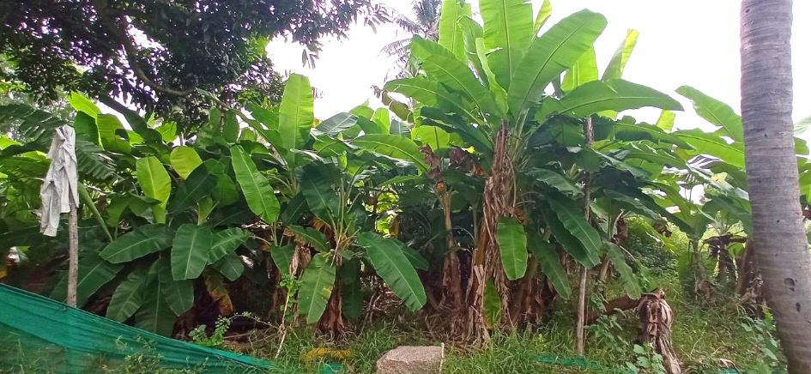
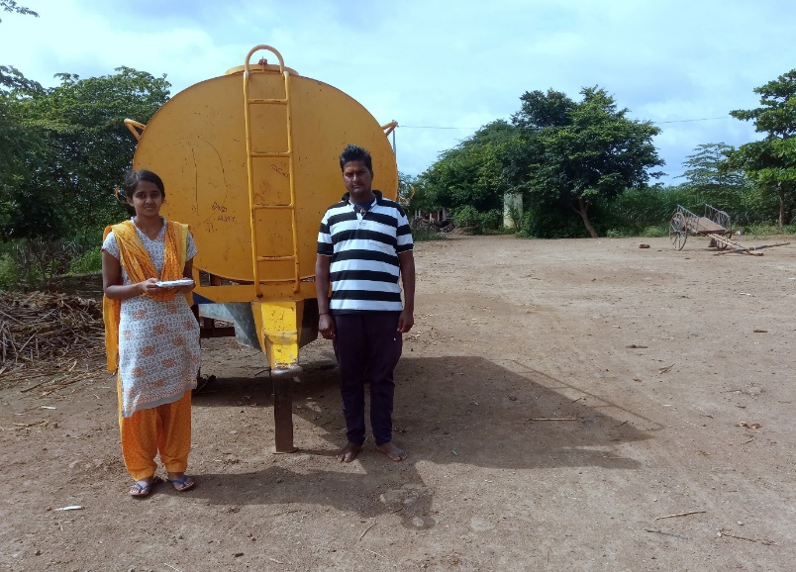
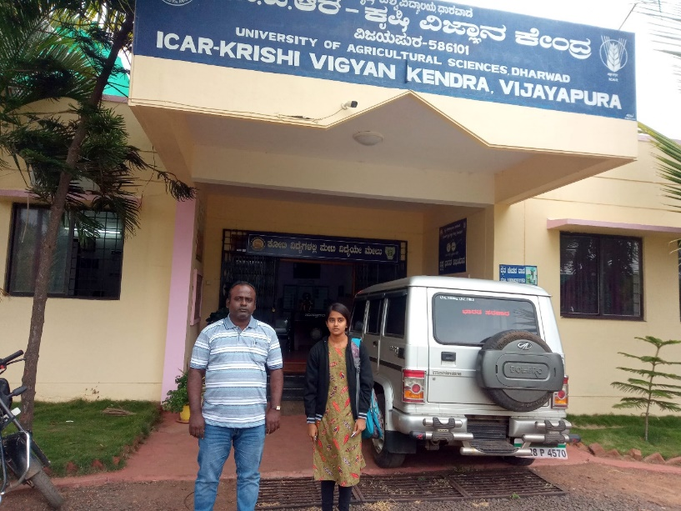
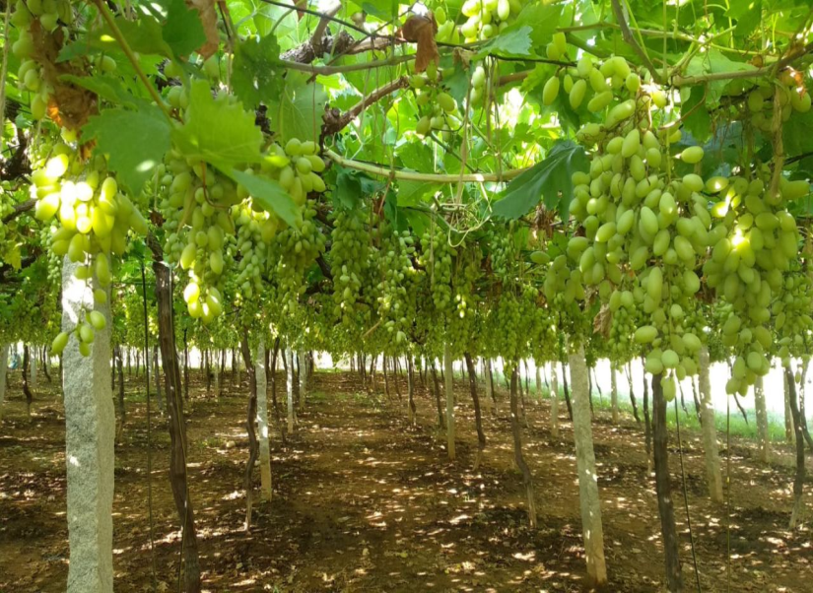
Banana orchard in Jeeragal
Interaction with water seller
Collecting farmers’ contacts from KVK
Grape Orchard in Tikota

Slide 47
Thank you

